Slide 1
Fake Colorized Image Detection
Presented by,
Jyothi Lakshmi
4AL16CS129
CSE, 8th sem
Under the guidance,
Dr.Mohideen S Badhusha
DEPT of CSE

Slide 2
CONTENTS
2
INTRODUCTION
PROBLEM STATEMENT
OBJECTIVES
SCOPE FOR THE STUDY
METHODOLOGY
RESULTS
7. CONCLUSION
8. FUTURE STUDIES
9. REFERENCES

Slide 3
1. INTRODUCTION
3
Image forensics aims to detect the manipulation of digital images.
Image editing technologies has increased both the ease with which images can be manipulated and the difﬁculty in distinguishing between altered and natural images.
Although image editing techniques can provide signiﬁcant aesthetic or entertainment value, they may also be used with malicious intent.
In addition to the conventional image editing techniques such as splicing, copy-move and retouching, more image editing techniques, such as colorization and image generation, are proposed.

Slide 4
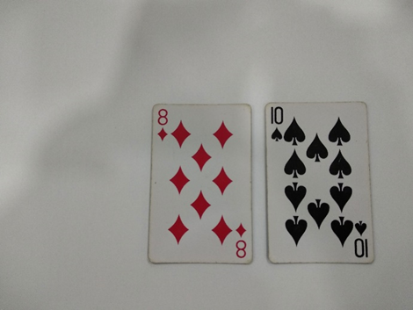
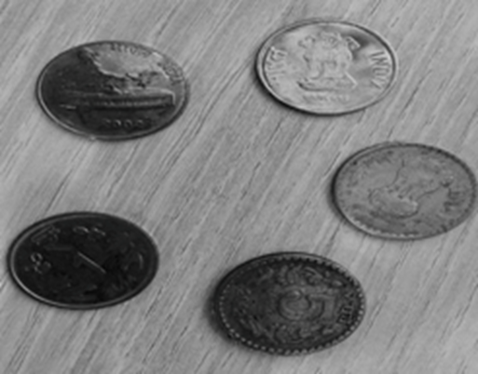
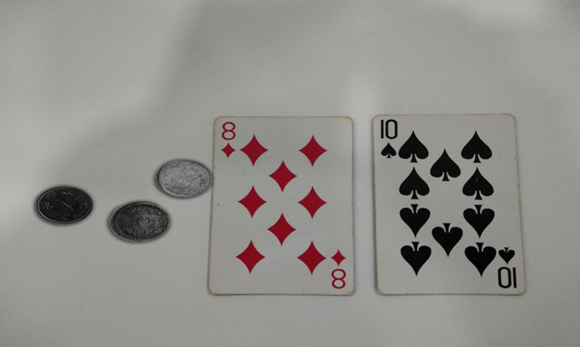
IMAGE SPLICING
4
Image Splicing is a process of making a composite picture by cutting some object from
image and adding it to the some other image

Slide 5
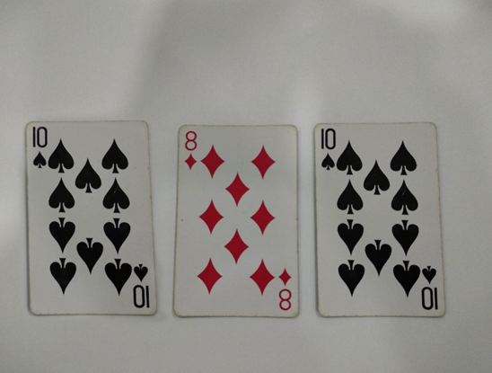
COPY-MOVE FORGERY
5
Copy Move forgery is a process of making a composite picture by cutting some object from image and adding it to the same image.

Slide 6
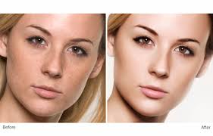
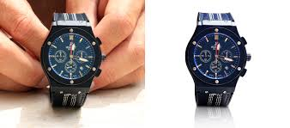
IMAGE RETOUCHING
6
Retouching operation is carried out mostly to enhance or reduce the image features. It refers to the process of manipulating photographs in order to slightly change the looks of a subject.

Slide 7
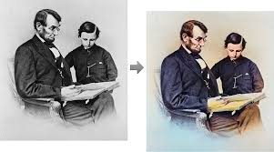
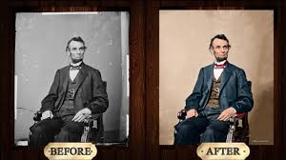
2. PROBLEM STATEMENT
7
An emerging image editing technique is colorization, in which grayscale images are colorized with realistic colors.

Slide 8
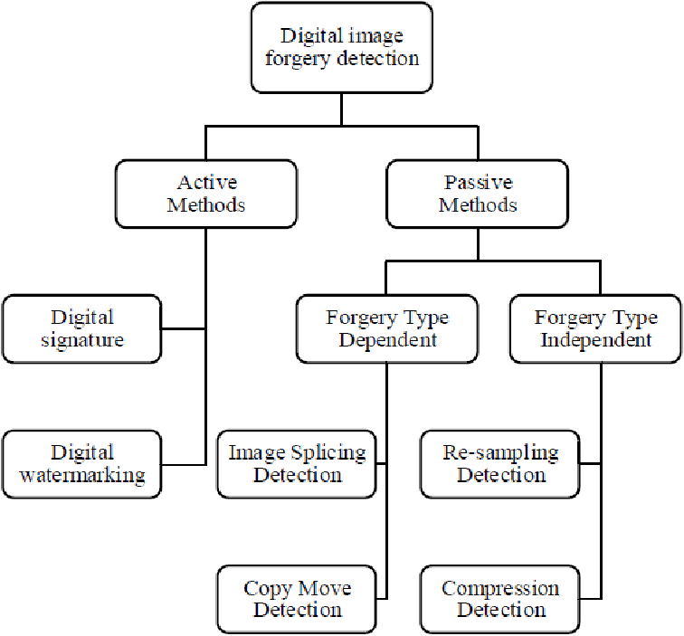
8
Image forensic technologies can be
categorized into two classes,
active techniques
passive techniques.

Slide 9
9
The active techniques usually refer to watermarking techniques, which embed authentication information in the to-be-protected images.
When the integrities of these images demand veriﬁcation, watermark extraction procedures are performed and the extracted watermarks are compared to the original watermark to detect forgeries.
Since the active techniques require the watermark to be embedded prior to detection, the applications, in practice, are limited.

Slide 10
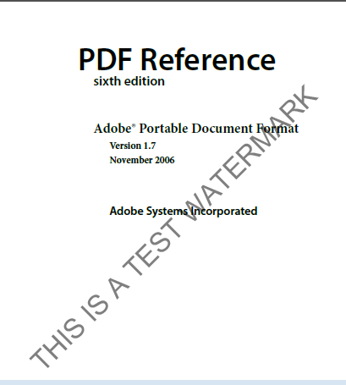
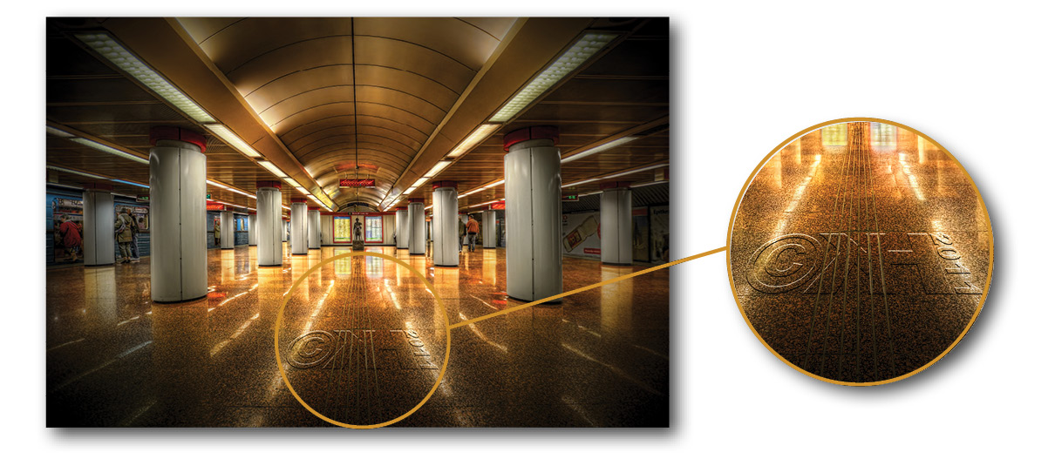
10

Slide 11
11
Passive image forgery detection approaches detect the manipulations to the input images directly.
No forensic technique has yet been invented to identify whether an image is colorized.
If these images are examined by humans, the cost increases drastically as the number of to-be-examined images increases. Obviously, detection via human eyes is insufﬁcient for the big data era.
Fake colorized images are visually indistinguishable, if no ground-truth images exist for comparison.

Slide 12
3. OBJECTIVES
12
It is observed that, when compared colorized images with natural images, possess statistical differences for the hue and saturation channels.
Besides, It is also observed statistical inconsistencies in the dark and bright channels, because the colorization process will inevitably affect the dark and bright channel values.
Based on the observations, It is proposed two simple yet effective detection methods for fake colorized images:
Histogram-based fake colorized image detection.
Feature encoding-based fake colorized image detection.

Slide 13
REVIEW OF FORGERY DETECTION
13
Most of the traditional forgery detection techniques can be categorized into three classes,
Copy-move detection
Splicing detection
Image retouching detection.

Slide 14
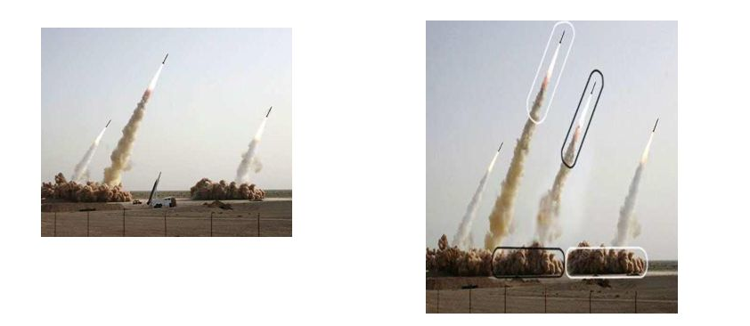
COPY-MOVE DETECTION
14
Copy-move detection relies on identifying duplicated regions in a tampered image. The detection can be performed via searching the most similar two units (such as patches)

Slide 15
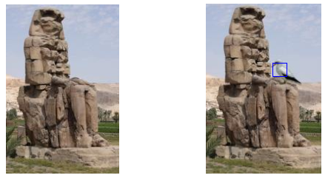
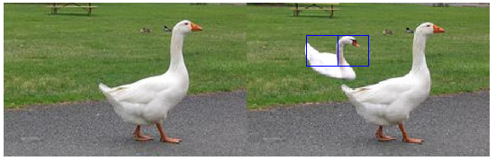
SPLICING DETECTION
15
Splicing detection approaches detect the tampered regions with various traces (features), which usually reveal the inconsistencies between the tampered regions and the unchanged regions.

Slide 16
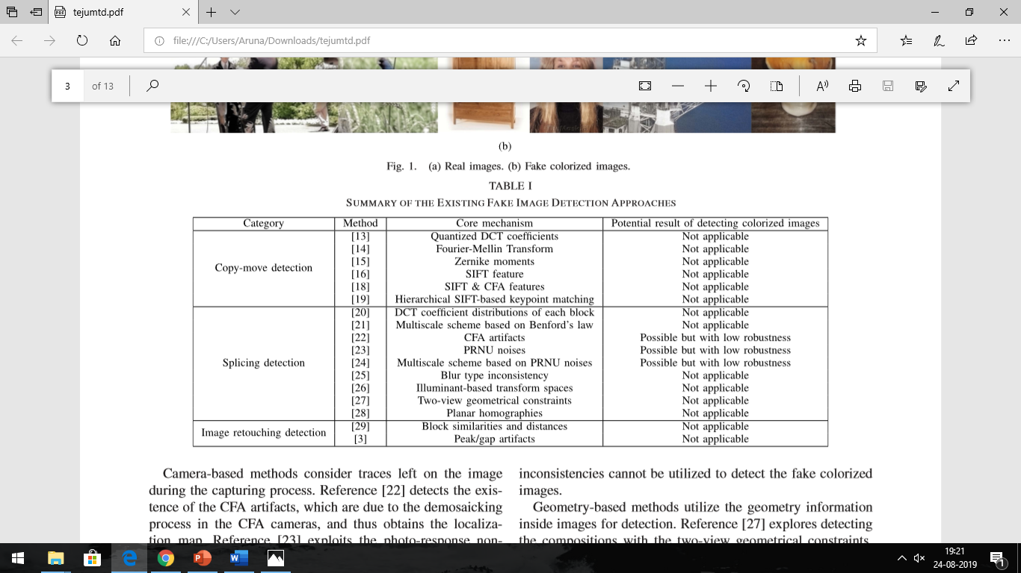
SUMMARY OF THE EXISTING FAKE IMAGE DETECTIONAPPROACHES
16

Slide 17
5. METHODOLOGY
17
Observations and Statistics
According to the observation, the colorized images tend to possess less saturated colors, and the colorization method favors some colors over others, though these differences are difﬁcult to be visually perceived.
We calculate the normalized histograms (each containing 200 bins) of the hue and saturation channel in 15000 natural images and their corresponding fake colorized images, separately.
The statistics of the natural and fake colorized images are different in both the hue and saturation channels, and there also exist statistical differences (especially for the peaks in the histograms) among the fake images generated by different colorization methods.

Slide 18
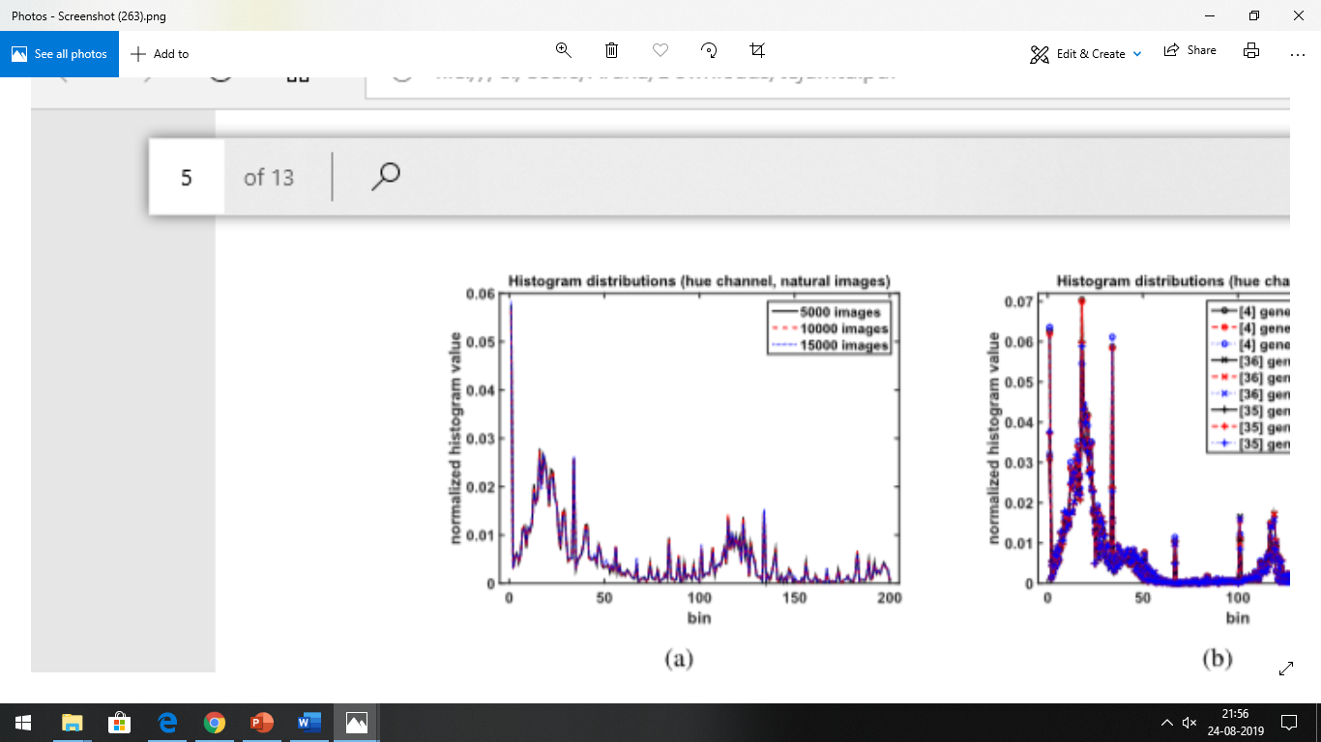
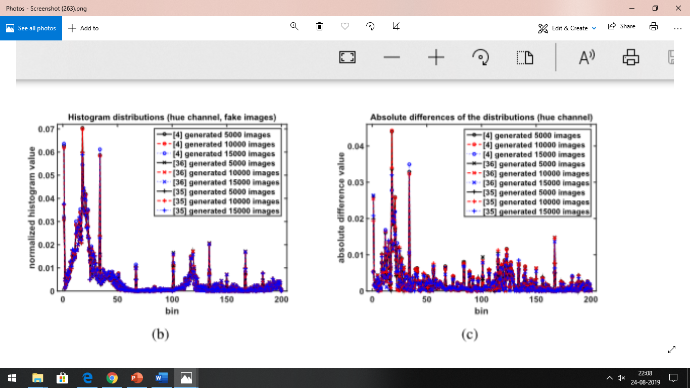
18

Slide 19
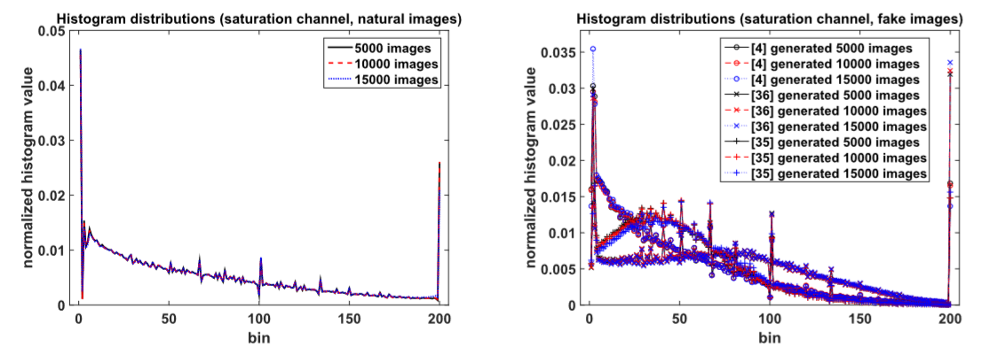
19

Slide 20
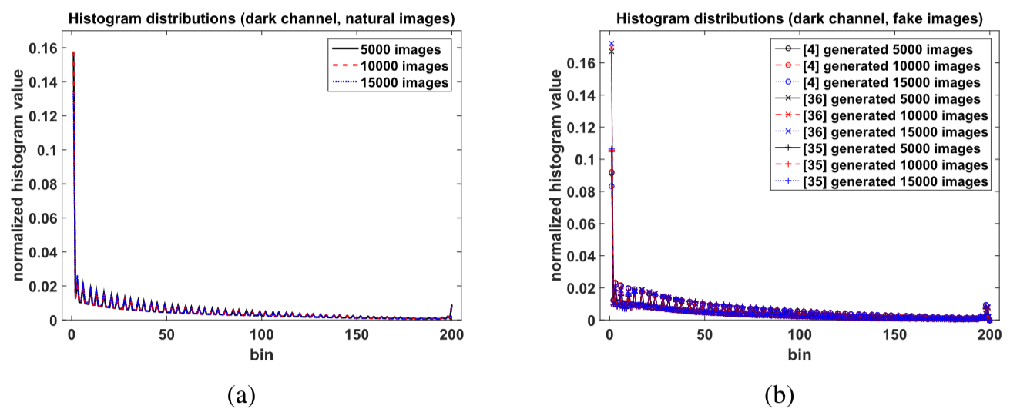
20

Slide 21
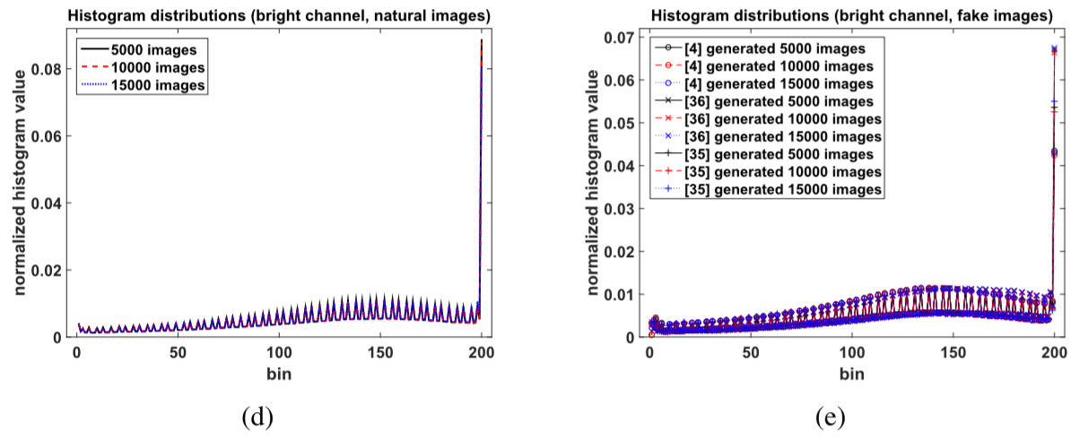
21

Slide 22
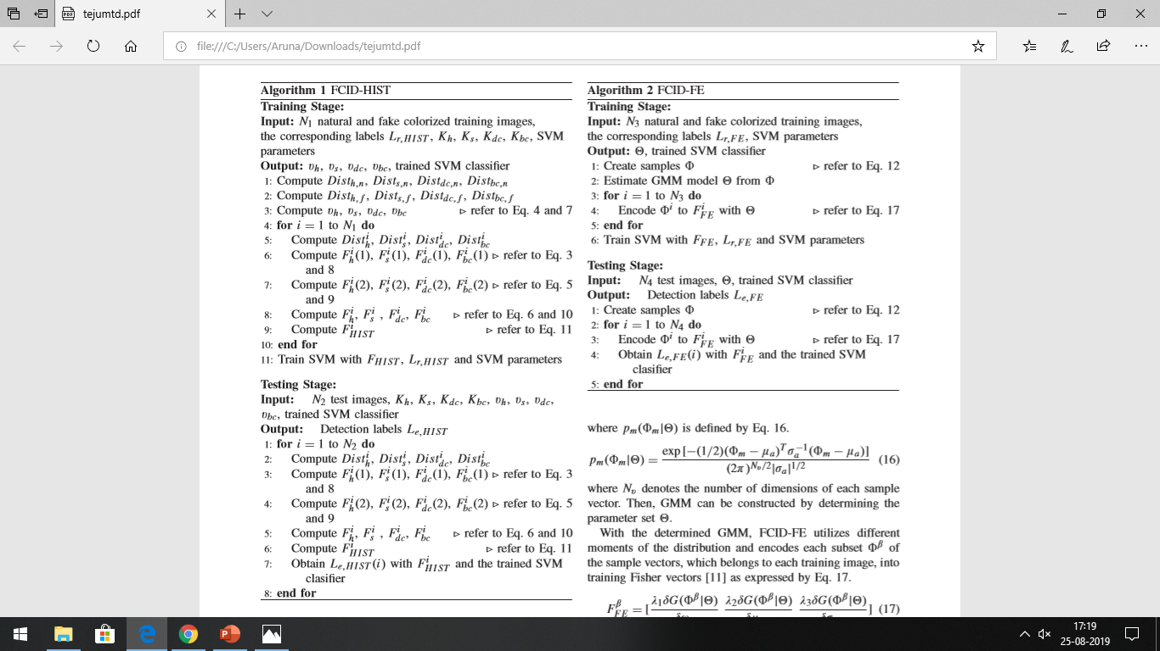
ALGORITHM 1 - FCID-HIST
22

Slide 23
ALGORITHM 2 – FCID-FE
23

Slide 24
6. RESULTS
24
Setups and Measurements
In our experiments, both the half total error rate (HTER) measurement and the receiver operating characteristic (ROC) curve are employed to evaluate the performances of the proposed methods.
Denoting P, N, TP and TN as the positive samples, negative samples, true positive samples and true negative samples respectively,
HTER is deﬁned as
HTER= FPR+FNR 2 = FP/(TN+FP)+FN/(TP+FN)/ 2

Slide 25
B. Databases
We create the database D1 for parameter selection and validation by employing 10000 fake colorized images from the database ctest10k and their corresponding 10000 natural images from the ImageNet validation dataset .
The database D2 consists of 2000 natural images randomly selected from the ImageNet validation dataset and their corresponding fake images, which are generated.
The database D3 is constructed by randomly selecting 2000 fake colorized images from the results of “Colorful image colorization,” and 2000correspondingnaturalimages fromthe ImageNet validation dataset.
25

Slide 26
8. CONCLUSION
29
In this paper, we aimed to address a new problem in the ﬁeld of fake image detection: fake colorized image detection.
We observed that fake colorized images and their corresponding natural images possess statistical differences in the hue, saturation, dark and bright channels.
We proposed two simple yet effective schemes, FCID-HIST and FCID-FE, to resolve this detection problem.
The results demonstrate that both FCID-HIST and FCID-FE perform decently against different colorization approaches and FCID-FE provides more consistent and superior performances compared to FCID-HIST in most of the tests.

Slide 27
9. FUTURE STUDIES
30
As our results indicate, the performance of our current methods sometimes degrades obviously when the training images and the testing images are generated from different colorization methods or different datasets, thus blind fake colorized image detection features.
Moreover, better feature encoding approaches can be considered for improving performance, as well as the optimization of the detection features and parameters to improve the custom features constructed in this study.

Slide 28
10. REFERENCES
31
G. Larsson, M. Maire, and G. Shakhnarovich, “Learning representations for automatic colorization,” in Proc. Eur. Conf. Comput. Vis. (ECCV), 2016, pp. 577–593.
G. Charpiat, M. Hofmann, and B. Schölkopf, “Automatic image colorization via multimodal predictions,” in Proc. Eur. Conf. Comput. Vis. (ECCV), 2008, pp. 126–139.
R. Zhang, P. Isola, and A. A. Efros, “Colorful image colorization,” in Proc. Eur. Conf. Comput. Vis. (ECCV), 2016, pp. 649–666.

Slide 29
THANK YOU ☺

